Slide 1
Gender Classification of Image Data Exploring Bias
Team 8: Nansu Wang |Haoliang Jiang | Emma Mavis | Godwin Anguzu

Slide 2
Introduction and Motivation
Many possible facial image applications
Healthcare
Security
AI Vehicles
Advertising
Image classification bias in race, gender and age more thoroughly documented, but no comprehensive solutions
Imbalance in data impacts model performance
We study these imbalances to understand how this affects detection of less represented groups

Slide 3
Data
UTKFace dataset – publicly available large-scale face dataset with large age span (labelled 0 to 116 years old)
9778 facial images
Race - White, Black, Asian, Indian, and Others
Gender - Male, female
Age groups - < 13 yrs, 13 to 25 yrs, 26 to 45 yrs, > 46 yrs

Slide 4
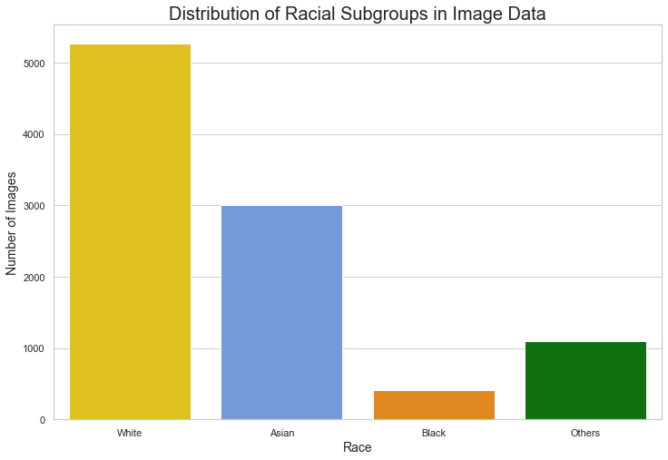
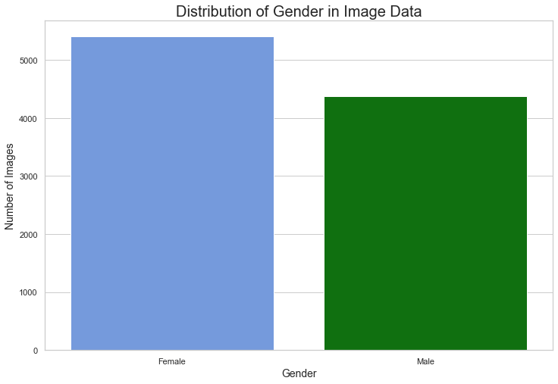
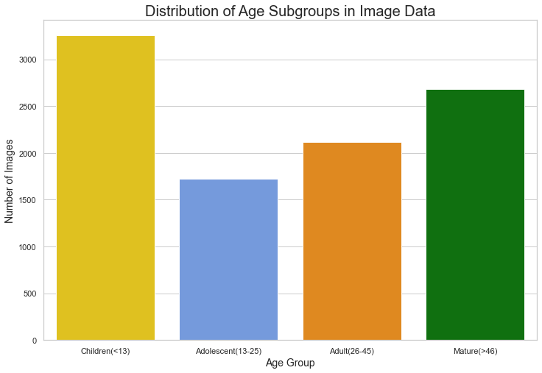
Data
Exploratory data Analysis
Race
Gender
Age
Distribution of groups within features are highly imbalanced

Slide 5
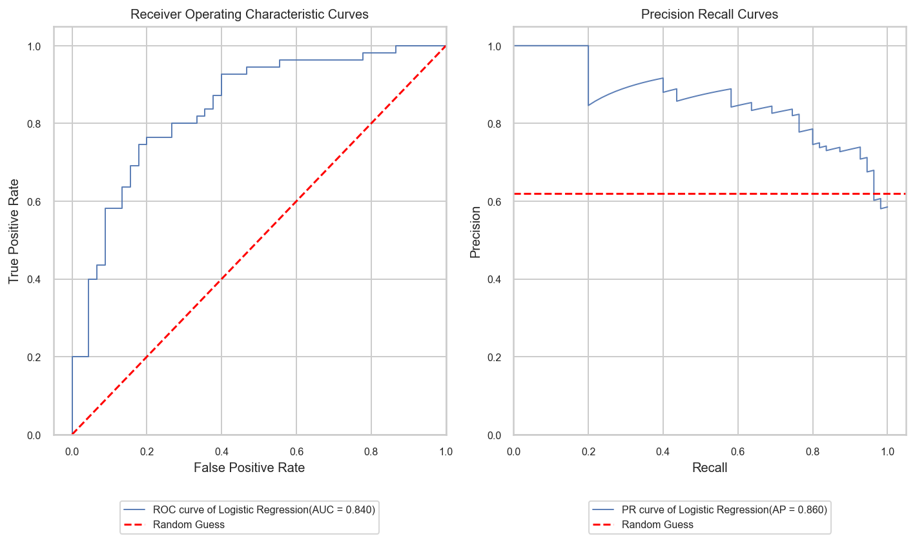
Results
First Modeling on overall data: Logistic Regression ON SUBSET

Slide 6
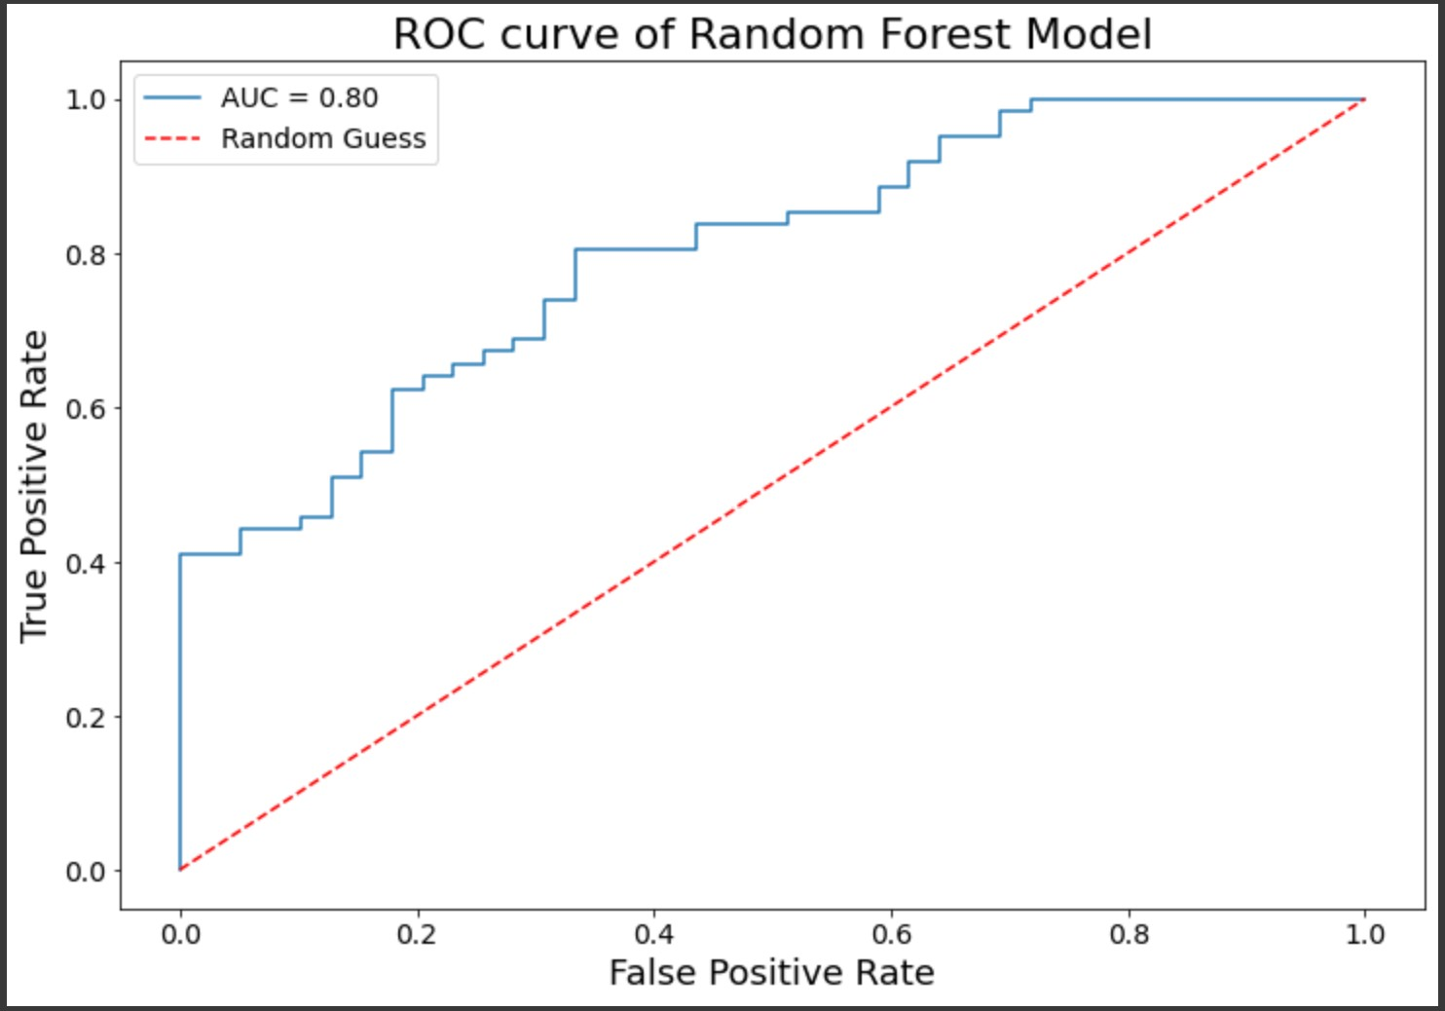
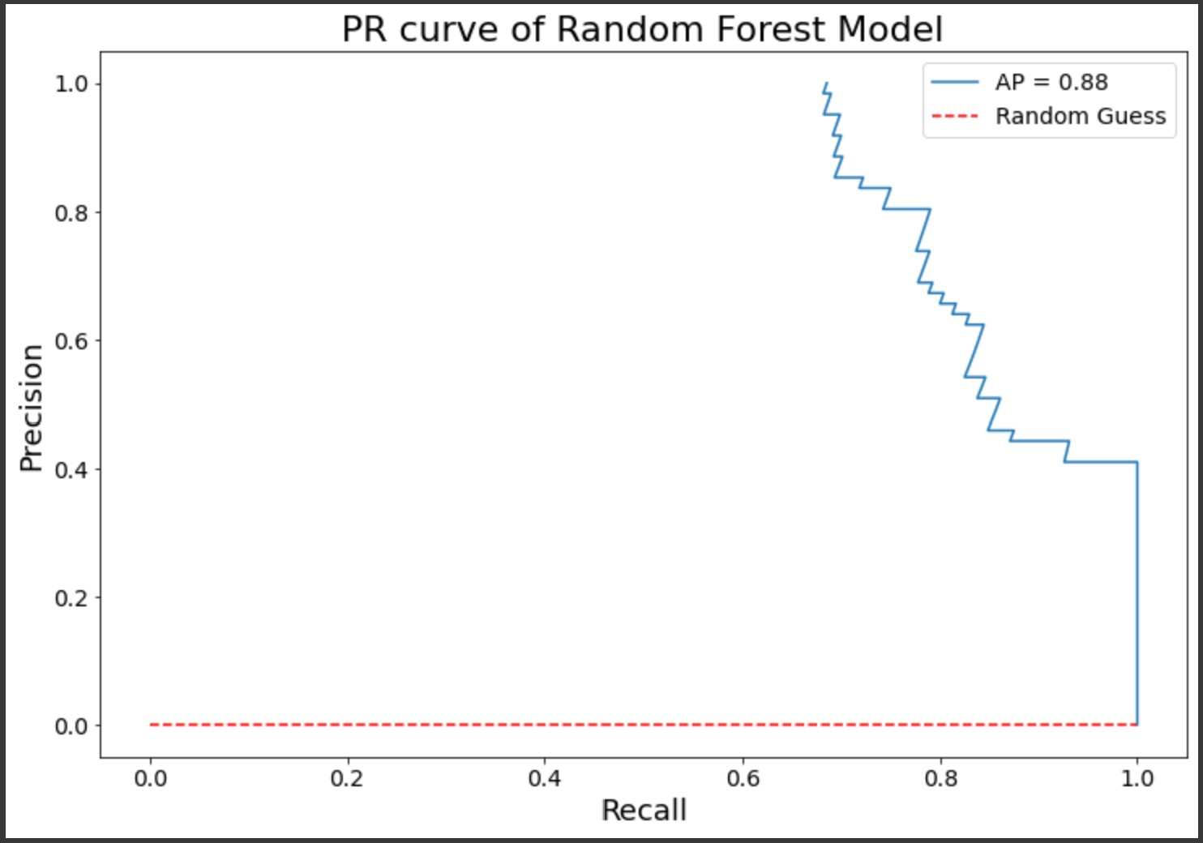
Results
First Modeling on overall data: Random Forest

Slide 7
Results
First Modeling on overall data: Neural Network
Output
Output
Tweaking of Pre-Trained Neural Networks
Fully-Connected Layer
Fine-tuning using
small learning rate
of a few epochs
Fully-Connected Layer
Training Until Converging
Dropout
Dropout
Average Pooling
Average Pooling
Pre-trained Model
Pre-trained Model
Freeze
Defreeze
Input Images
Input Images

Slide 8

Results
First Modeling on overall data: Neural Network
ResNet101V2
AP
AUC
DenseNet169
ResNet152V2
ResNet50V2
AUC/AP
VGG19
Xception
InceptionResNetV2
DenseNet121
Millions of parameters

Slide 9
Results
First Modeling on overall data: Neural Network
ROC and PR for ResNet101V2

Slide 10
Methods and Experiments
In addition to modeling whole data, we run the following experiments
For race subgroups, a held-out method:
For gender, create skew:
Train
80% Male
Validate
80% Male
Test
Train
Validate
Test
All
20% Female
20% Female
Leave out one
Leave out one
Train
80% Female
Validate
80% Female
Test
20% Male
20% Male

Slide 11
Results
Experimentation modeling: ResNet101V2
Comparison of Held-out Racial Subgroup
Subgroup Evaluated On
AUC/AP
White
Black
Asian
Others
White
Subgroup Held Out
Black
Asian
Other

Slide 12
Results
Experimentation modeling: ResNet101V2
Comparison of Skewed Gender

Slide 13
Conclusions
Understanding overall imbalances in racial groups
We see drastic performance differences when applying a model trained on a subset of racial groups
Most notably is the performance on the Black subgroup every time
The values follow the relative density of the subgroups in the data
Understanding classification of gender
Neural network generally perform poor at classifying gender (imbalanced)
Again, performance follows the relative density of female vs male in the data
Implications
Poor performance across subgroups by neural networks attributed to imbalance in racial groups and in gender make up
Balancing racial groups before facial recognition models is vital to achieve better classification results
When this is not possible (as in most of the time) methods for mitigating bias need to be at forefront of machine learning pipeline
.
Notes:
-- don’t use jargon. Many people don’t know what reach means.
To determine the proportion of eligible adolescents treated for drug susceptible pulmonary TB enrolled on 99DOTS
To determine factors associated with enrollment of adolescents on 99DOTS
I would add a third objective: To describe adherence and treatment outcomes among adolescents enrolled on 99DOTS

